Slide 1

DIABETES PREDICTION WITH LINEAR REGRESSION AND CLASSIFICATION MODEL
Team : 5240 Group
This Photo by Unknown Author is licensed under CC BY-NC-ND

Slide 2

Topics Covered
Introduction
Problem solving
Data Description
Data Processing
Exploratory Data analysis
Algorithms used
Comparing Algorithm
Results evaluation
Conclusion and Interpretation
This Photo by Unknown Author is licensed under CC BY-SA-NC

Slide 3

Introduction
Diabetes Health prediction : It refers that expecting diabetics health by different machine learning models.
Exploratory Data Analysis : Detection and management outliers, missing values and also interactions among predictors through visualization
Model training : Training models for predicting diabetic health status that includes linear regression, Random Forest Classifier, and Gradient Boosting.
Model performance: Metrics such as accuracy, RMSE and confusion matrix are used to assess how each model will work.

Slide 4
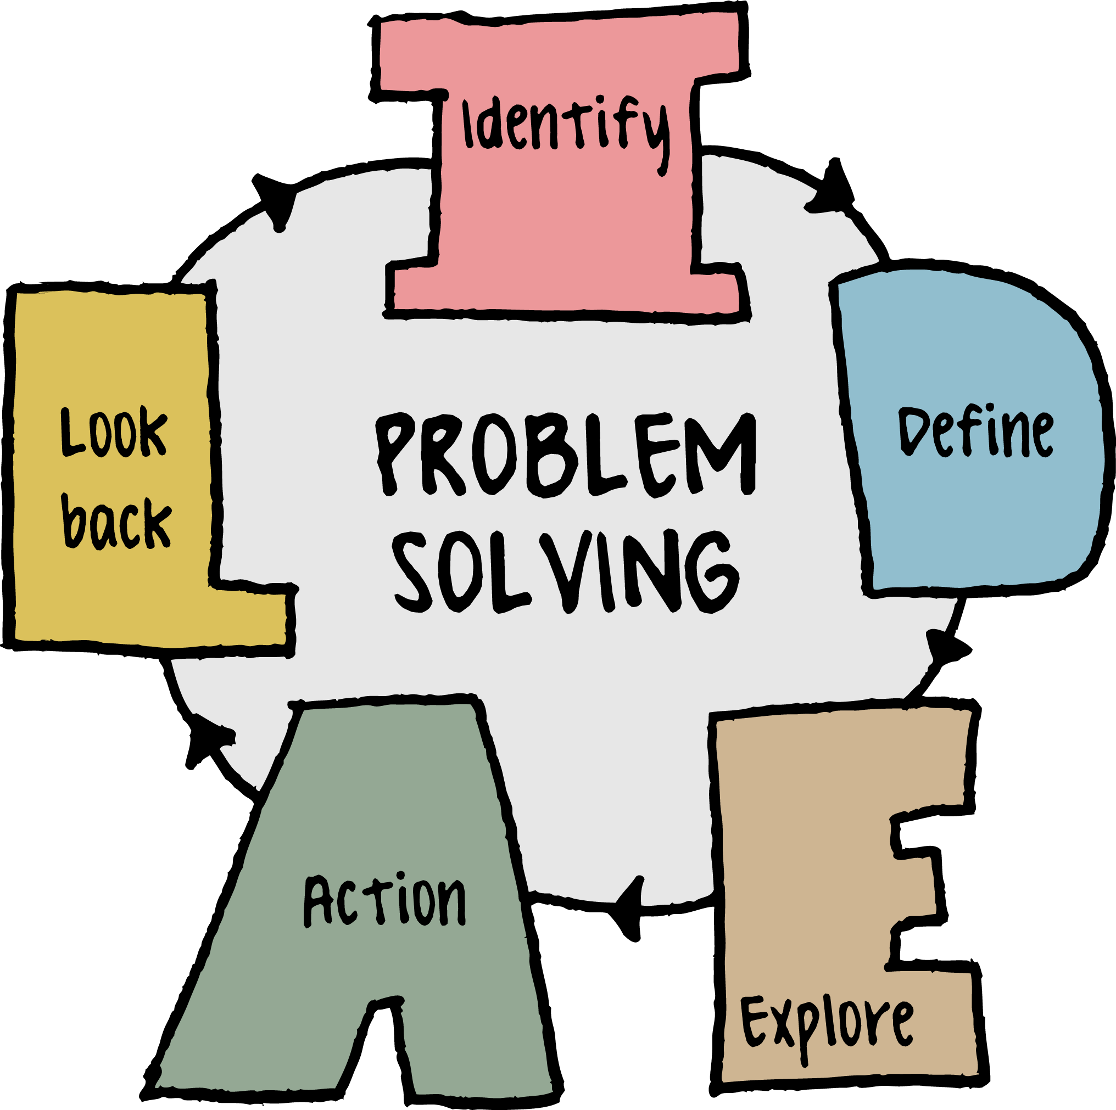
Problem to solve
Which of this health indicators are the best predictor of diabetes?
Can we guess the diabetes status of persons according their survey responses?
What are the model that performs good for guessing these outcomes in the context of given data?
This Photo by Unknown Author is licensed under CC BY

Slide 5

Dataset
Diabetes Health Indicator Dataset
The Dataset has 250k plus records and 22 columns

Slide 6

Data Set Explanation
Diabetes_012 : Diabetes status of individual (No Diabetes , Diabete only during pregnency , Diabetes )
HBP : High Blood pressure of a individual , which is risk factor of diabetes
Highcol : in this dataset which indicates ,, individuals has high level of cholesterol levels which is risk factor cardiovascular diseases
CholCheck: individual has checked the cholesterol level in a specified time frame
BMI:Body Mass Index of a individual , Bmi indicates various categories of weights which are associated various health risks , including diabetes
GenHealth:General Health Perception of individual , which is a self rated health status
This Photo by Unknown Author is licensed under CC BY-SA

Slide 7

Dataset Explanation
Smoker: This attribute indicate whether the patient currently smokes tobacco. '1' for yes, '0' for no.
Stroke: This variable would indicate if the patient has ever had a stroke. '1' for yes, '0' for no.
HeartDiseaseorAttack : This variable indicate , if the patient have told they have heart diseases or have a heart attack
PhysActivity: This would indicate whether the patient engages in physical activity
HvyAlcoholConsump:This variable refers to heavy alcohol consumption
MentHlth:This could indicate the number of days in the past month that the respondent experienced poor mental health
This Photo by Unknown Author is licensed under CC BY-SA-NC

Slide 8

Data Preparation
Data Cleaning : It is the process of removing the outliers , incorrect values and missing values in a dataset
Feature Encoding : In our dataset all the variables are look like categorical encoding of 1’s and 0’s . If we have as categorical labels in our dataset we can do one hot encoding by using pd.get_dummies
Data Splitting : When training the machine learning model we need to split the dataset into 80 -20 rule The training dataset fit the model . The testing data evaluates the performance of model
This Photo by Unknown Author is licensed under CC BY-NC-ND

Slide 9
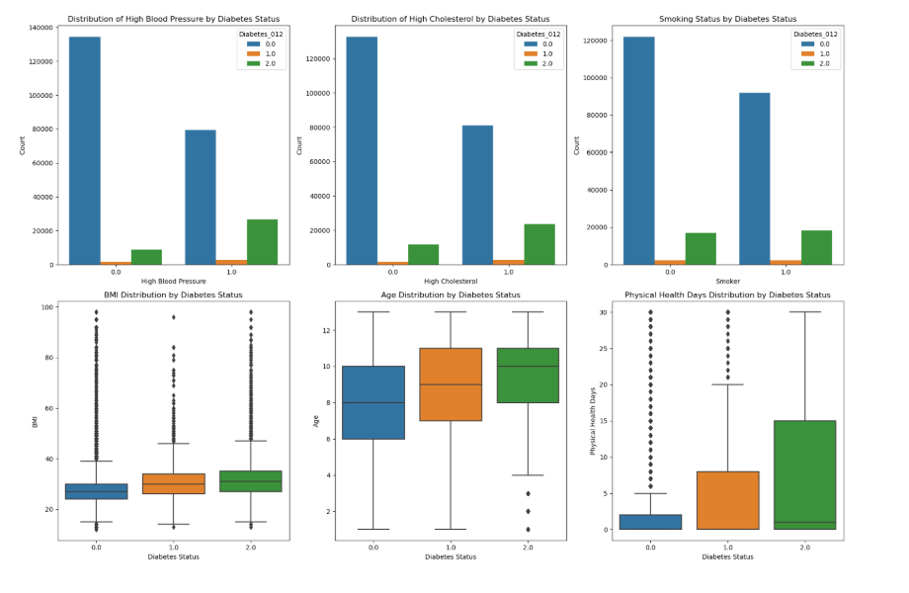
Exploratory Data Analysis

Slide 10
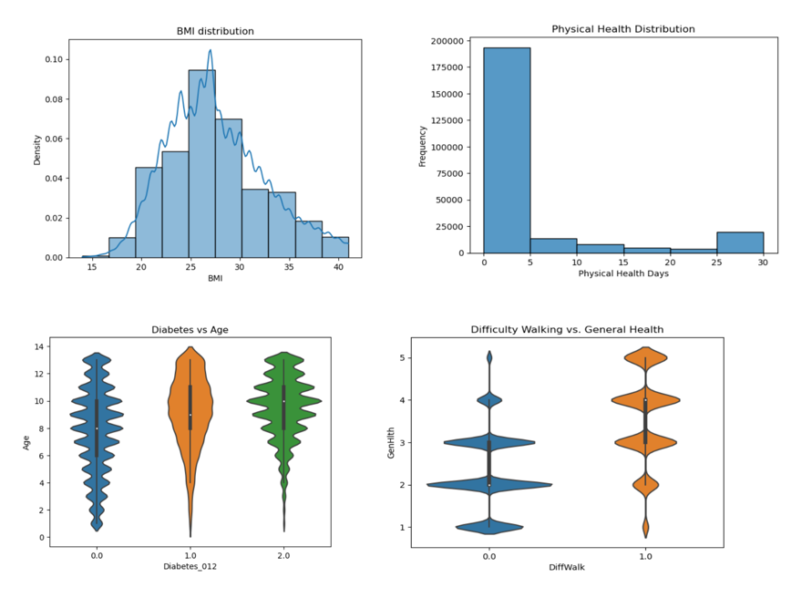
Exploratory Data Analysis After Removal of Outliers

Slide 11

Algorithms Used
Random Forest Classifier is the ensemble technique which uses many decision trees and average the final score
Linear Regression Model : It is used for predicting the dependent variable with respect to different independent variables . It fits the Predicted values with a line with independent variables
Gradient Boost Regressor : It used to sequencialy build weak decision trees and combines their predictions to improve accuracy of regression tasks
This Photo by Unknown Author is licensed under CC BY

Slide 12

Algorithm Comparison
Root Mean Squared Error for Linear Regression is 0.62
Root Mean Squared Error for Random Forest Regressor is 0.66
Root Mean Squared Error for Gradient Boost Regressor is 0.61

Slide 13
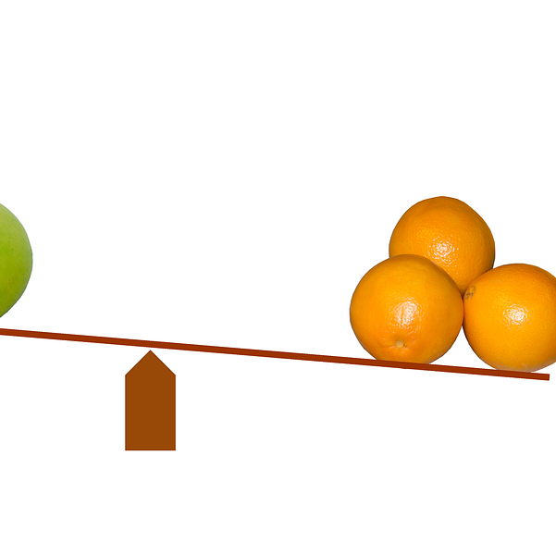
Comparison Conclusion
Linear Regression model has 0.62 Root Mean squared error which is lowest value when compared to other models . So Linear regression works well on test dataset. Even Random Forest Regressor has lowest Root Mean squared Error . So linear regressor has better RMSE and performs good on unseen Data

Slide 14


